Slide 1
Array and String in C

Slide 2
Objectives
At the end of this session you will understand:
Advantages of array
Types of array(1D and 2D)
1 D array
Initialization
Declaration
Operations on 1 D array
2 D array(Matrix)
Initialization
Declaration
Operations on Matrix
String declaration
String operation with library functions

Slide 3
What is Array?
Used to collect similar data in one unit.
C programming language provides a data structure called the array, which can store a fixed-size sequential collection of elements of the same type.
Example: Student’s 10 subject marks(All are Integer data)

Slide 4
What is Array?
All arrays consist of contiguous memory locations.
The lowest address corresponds to the first element and the highest address to the last element.
A specific element in an array is accessed by an index.
Two types :
Lowest element index-0(zero)
Highest element index-Size-1
1 Dimensional array(1 D)
2 Dimensional array(2 D)

Slide 5
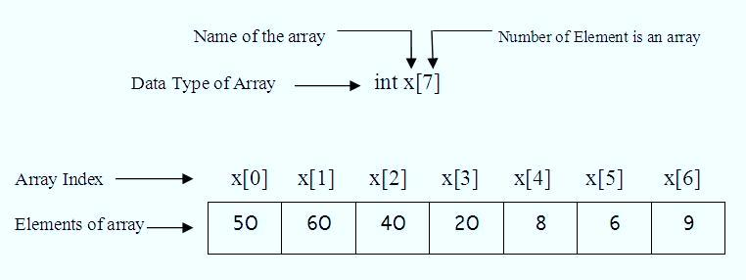
1 Dimensional Array
Declaration
Syntax - Data type array_name[size];
Example -

Slide 6
Operations on 1 Dimensional Array
Accept Elements from user.
Display all elements from array.
Display all elements at even and odd index.
Sum of all elements
Sum of elements at even and odd index.
Sorting
Searching

Slide 7
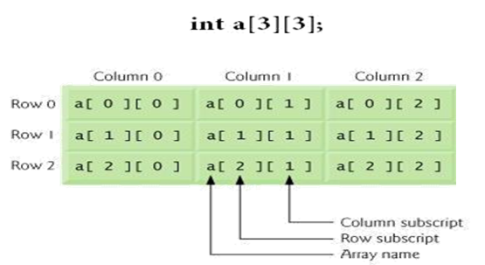
2 Dimensional Array
Also known as Matrix(containing rows and columns)
Declaration
Syntax - Data type array_name[row_size][col_size];
Example -

Slide 8
Operations on 2 Dimensional Array
Accept Elements from user in matrix.
Display all elements in matrix form.
Display sum of diagonal elements and non diagonal elements.
Find out Transpose of Matrix.
Sum of two matrices.
Multiplication of two matrices.

Slide 9
1 D Character Array-String
One-dimensional array of characters which is terminated by a null character '\0‘.
Declaration :
syntax-char string_name[size];
Initialization :
char String_name[size]={‘ch1’,’ch2’,……..’chN’};
OR
char string_name[size]=“string value”;

Slide 10
Operations on Strings
Accept string from user and Display
Length of the String
Reversing the String
Convert string to Uppercase and Lowercase
Compare two strings
Concatenate two Strings
Coping String into another String.

Slide 11
String Library function-string.h
Operations on Strings
Name | Syntax | Example | Use
strlen() | strlen(string) | strlen(“spark”) ans:-5 | Calculate no of characters from String.
strrev() | strrev(string) | strrev(“spark”) Ans:-kraps | Reverse the string
strupr() | strupr(string) | strupr(“spark”) Ans:-SPARK | Convert characters to uppercase
strlwr() | strlwr(string) | strlwr(“SPARK”) Ans:-spark | Convert characters to lowercase
strcmp() | strcmp(string1,string2) | strcmp(“Spark”,”SP”) Ans: Not Equal | Compares two strings by there ASCII value and cases Value 0=Equal strings Value 1=string>string2

Slide 12
String Library function-string.h
Operations on Strings
Name | Syntax | Example | Use
strcat() | strcat(string1,string2) | strcat(“sparks”,”institute”) Ans: sparkinstitute | Concatenate two strings.
strcpy() | strcpy(“target”,”source”) | strcpy(str,”spark”) Ans: str=spark | Copy source string to target string

